Slide 1
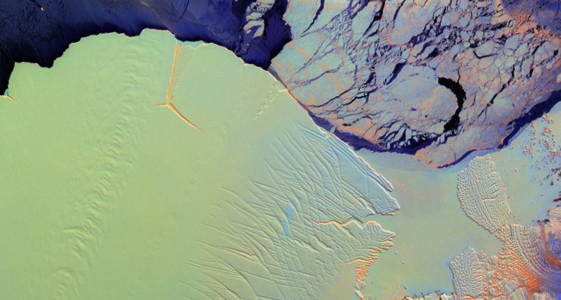
Elevation Changes on Antarctic Ice Shelves
Fernando S. Paolo Helen A. Fricker Laurie Padman
Scripps Institution of Oceanography
AAAS Pacific Division, 92nd Annual Meeting @ USD
6-14-2011

Slide 2
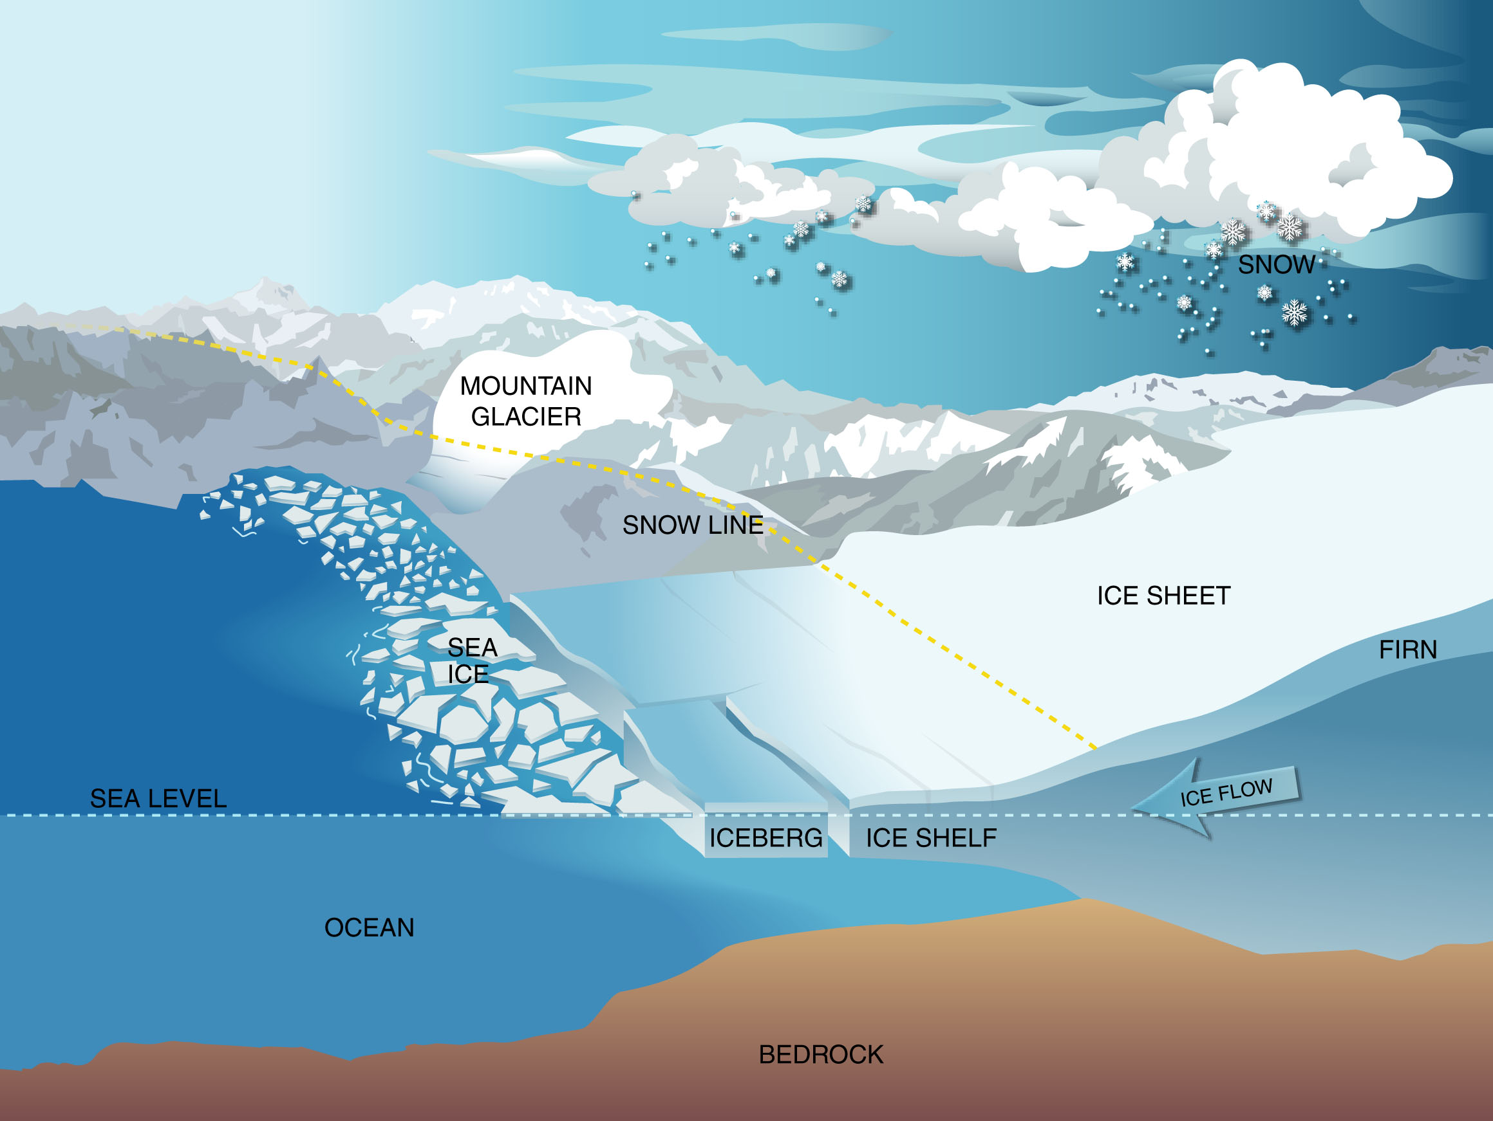
What is an ice shelf?
mass gain
mass loss
snowfall
iceberg calving
surface melt
ice flow
basal melt
Antarctica and Greenland together contain ~66m global sea-level equivalent
AAASPD, 92nd Annual Meeting @ USD – Fernando Paolo
Notes:
The boundaries of the ice sheets are wherever the ice comes into contact with something else i.e. rock or water. The four main boundaries are: 1) the ice shelf fronts from where icebergs calve; 2) the ice shelf bases which is in contact with the ocean; 3) the grounding zones where the grounded ice becomes freely floating; and 4) the base of the ice streams where fast flowing ice comes into contact with subglacial meltwater

Slide 3
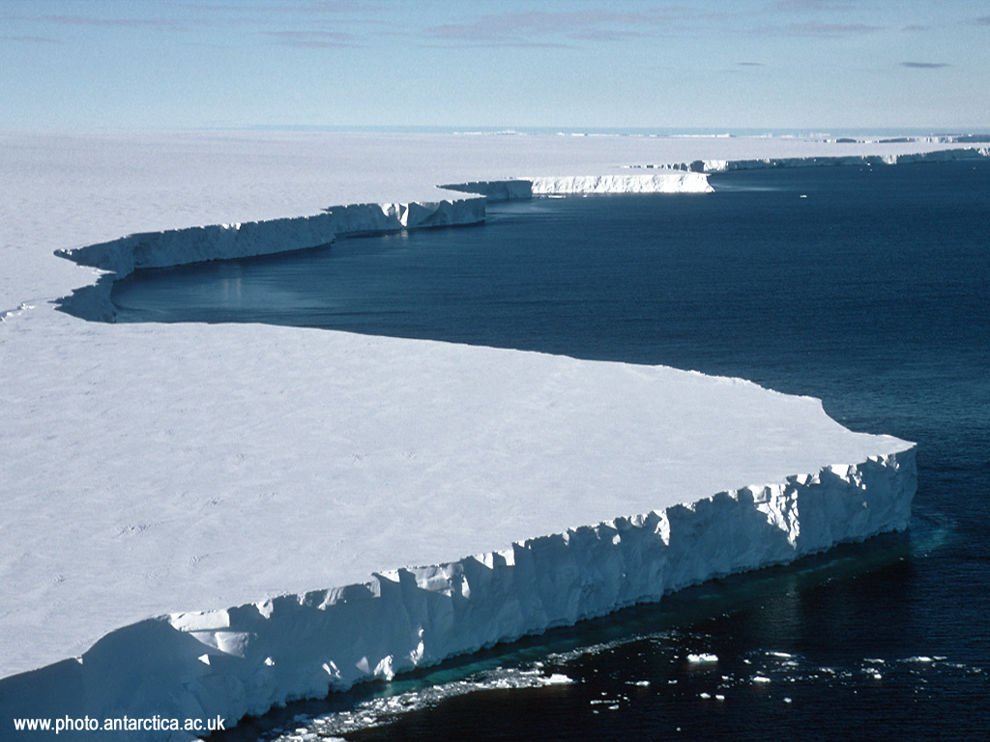
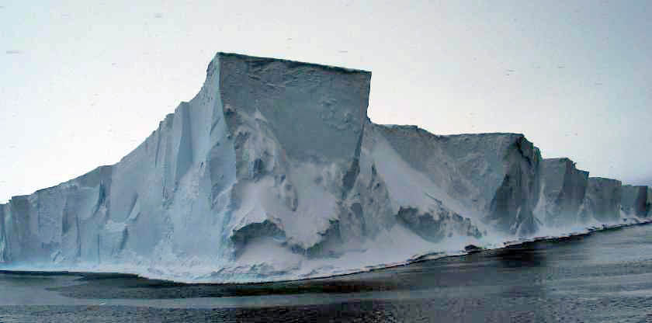
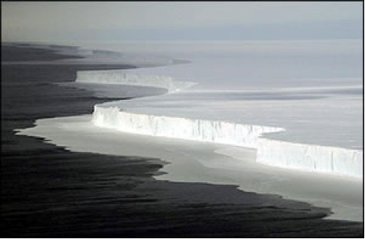
What do they look like?
Not the same as sea-ice!
Flat surface in general
In hydrostatic equilibrium
AAASPD, 92nd Annual Meeting @ USD – Fernando Paolo

Slide 4
Where are the ice shelves?
Larsen-C
Amery
Filchner-Ronne
ice shelf (11%)
grounded ice
ice free area
Ross
Loss of ice shelves does not directly affect sea-level, but they are tightly coupled to inland ice ➔ ice shelf mass balance does matter to sea-level
Ice shelves are in contact with both the ocean and the atmosphere, and therefore may be sensitive indicators of climate change
Most of the mass lost from the Antarctic ice sheet takes place in the ice shelves through iceberg calving (~65%) and basal melting (~30%)

Slide 5
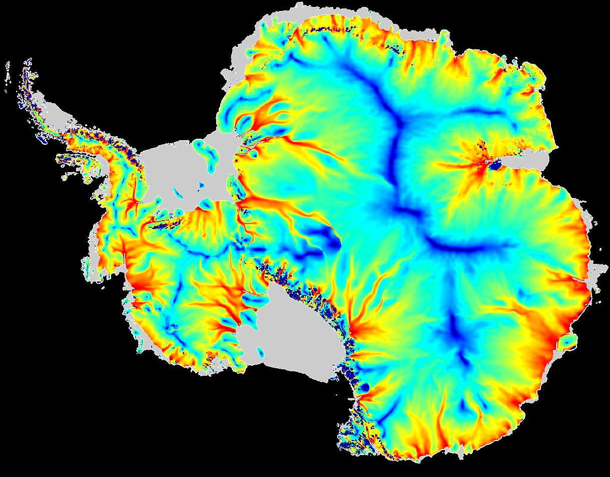
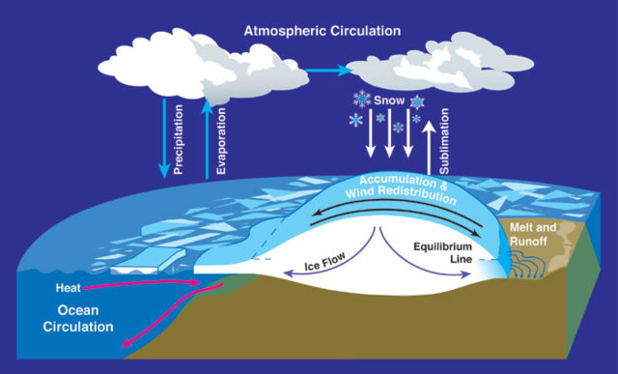
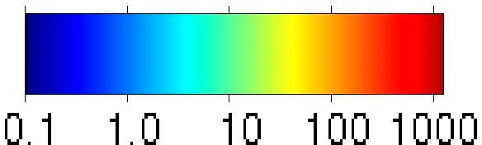
Why ice shelves are important?
Sensitive to climate change
Affect global circulation
Iceberg generation
Larsen-C
Amery
Filchner-Ronne
Ross
Ice velocity metres/year
More than 80% of ice flows towards the ocean through ice shelves
Buttressing role on grounded ice
AAASPD, 92nd Annual Meeting @ USD – Fernando Paolo

Slide 6
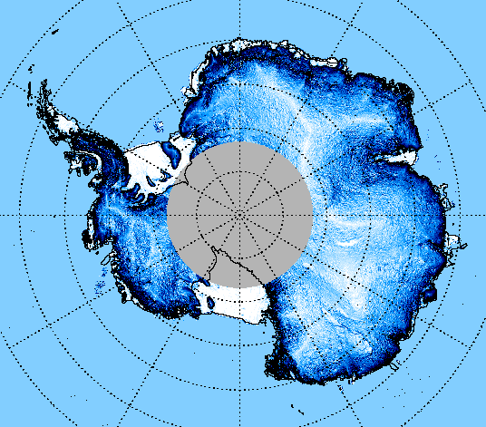
Why is difficult to study them?
Antarctica is the coldest, driest and windiest continent
Spatial scales
Ice shelves are all around the edges
Time scales
Different variability: seasons, years, decades
Amery
Filchner-Ronne
Ross
Ice velocity metres/year
AAASPD, 92nd Annual Meeting @ USD – Fernando Paolo

Slide 7
How do we study the vast ice sheets?

Slide 8
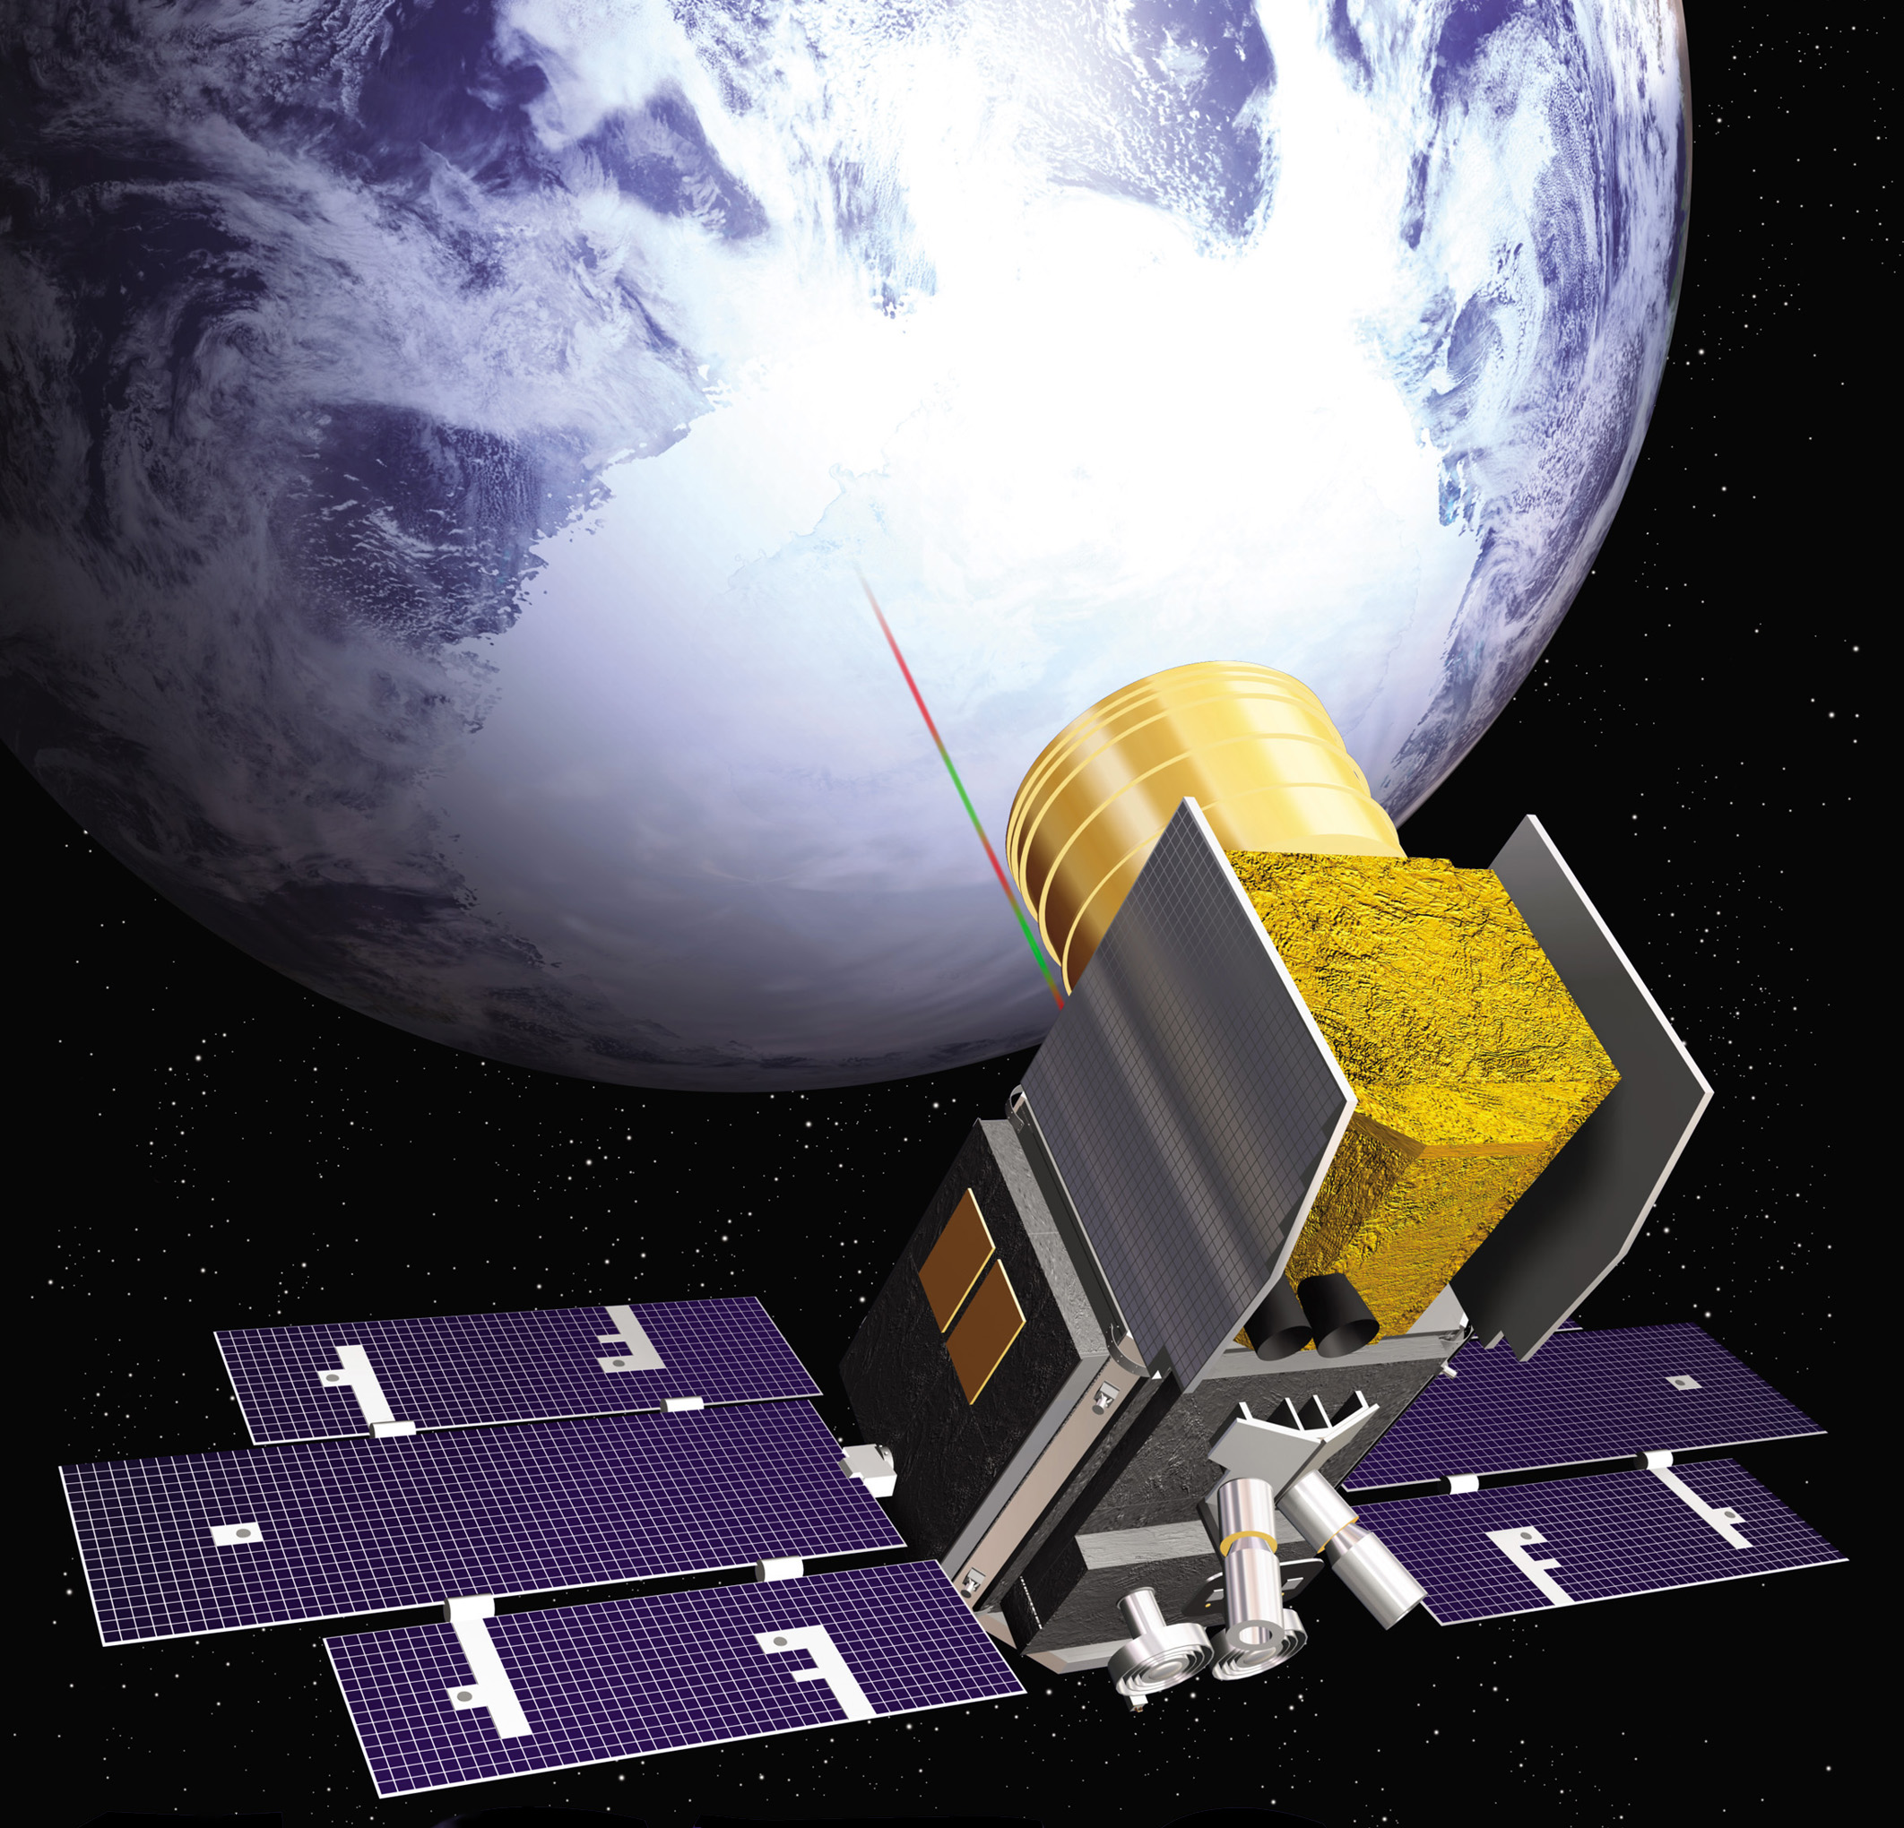
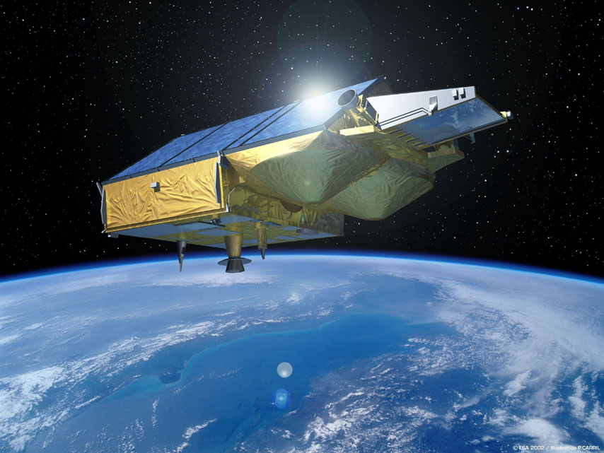
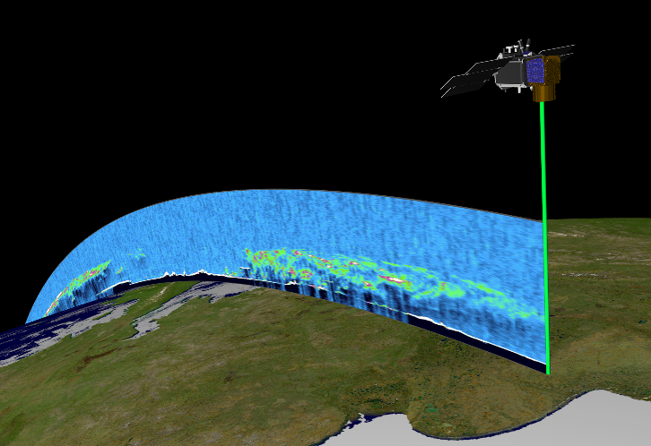
We use satellites
Larsen-C
Stable platform
Continuous in time and space
Global coverage
Amery
Filchner-Ronne
Ross
Ice velocity metres/year

Slide 9
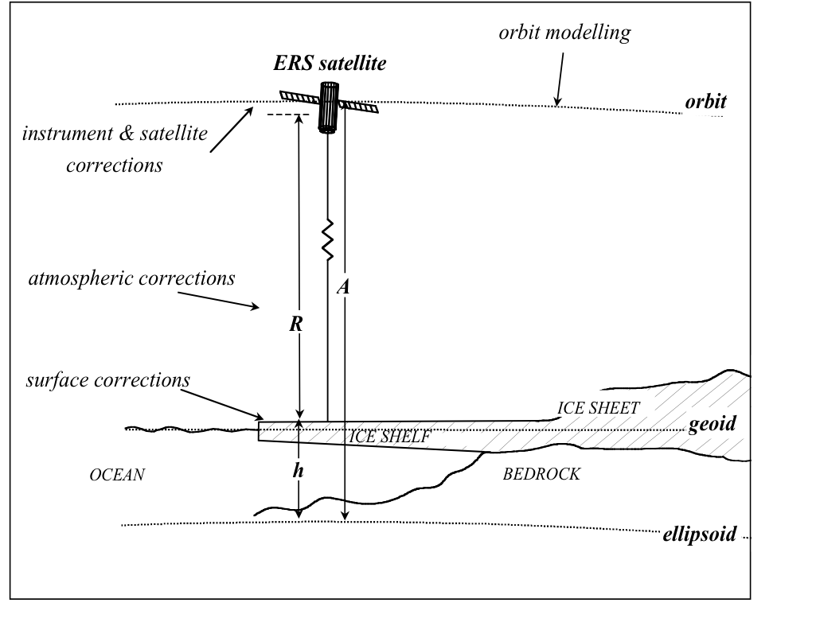
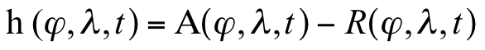
Satellite altimetry
If satellite altitude (A) is known, surface height (h) can be determined from range (R)
We look at height difference at crossing points
Larsen-C
Amery
Filchner-Ronne
Ross
Ice velocity metres/year
AAASPD, 92nd Annual Meeting @ USD – Fernando Paolo

Slide 10
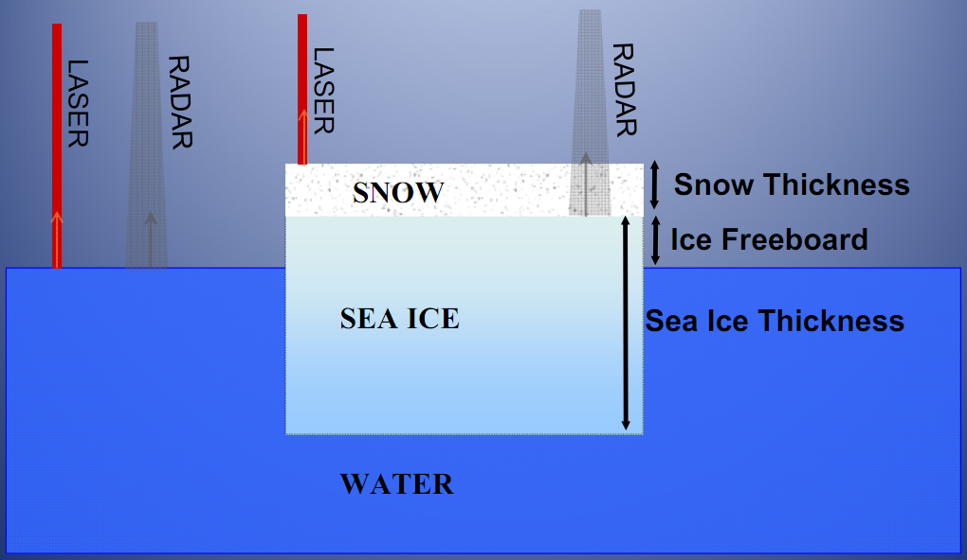
Radar vs Laser
Larsen-C
Amery
Filchner-Ronne
Ross
Picture: Sinéad Farrell
Ice velocity metres/year
Dielectric properties of the surface
Footprint: 20km x 65m
Surface slopes
Cloud coverage
Pointing errors
AAASPD, 92nd Annual Meeting @ USD – Fernando Paolo

Slide 11
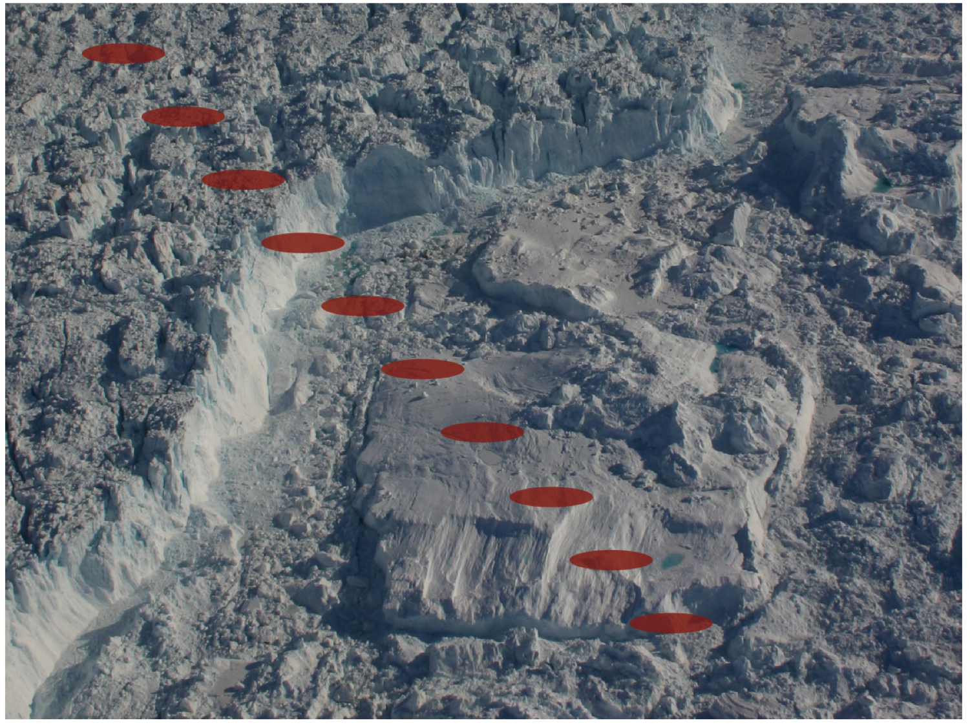
Surface elevations (laser-beam footprint) along ground track

Slide 12
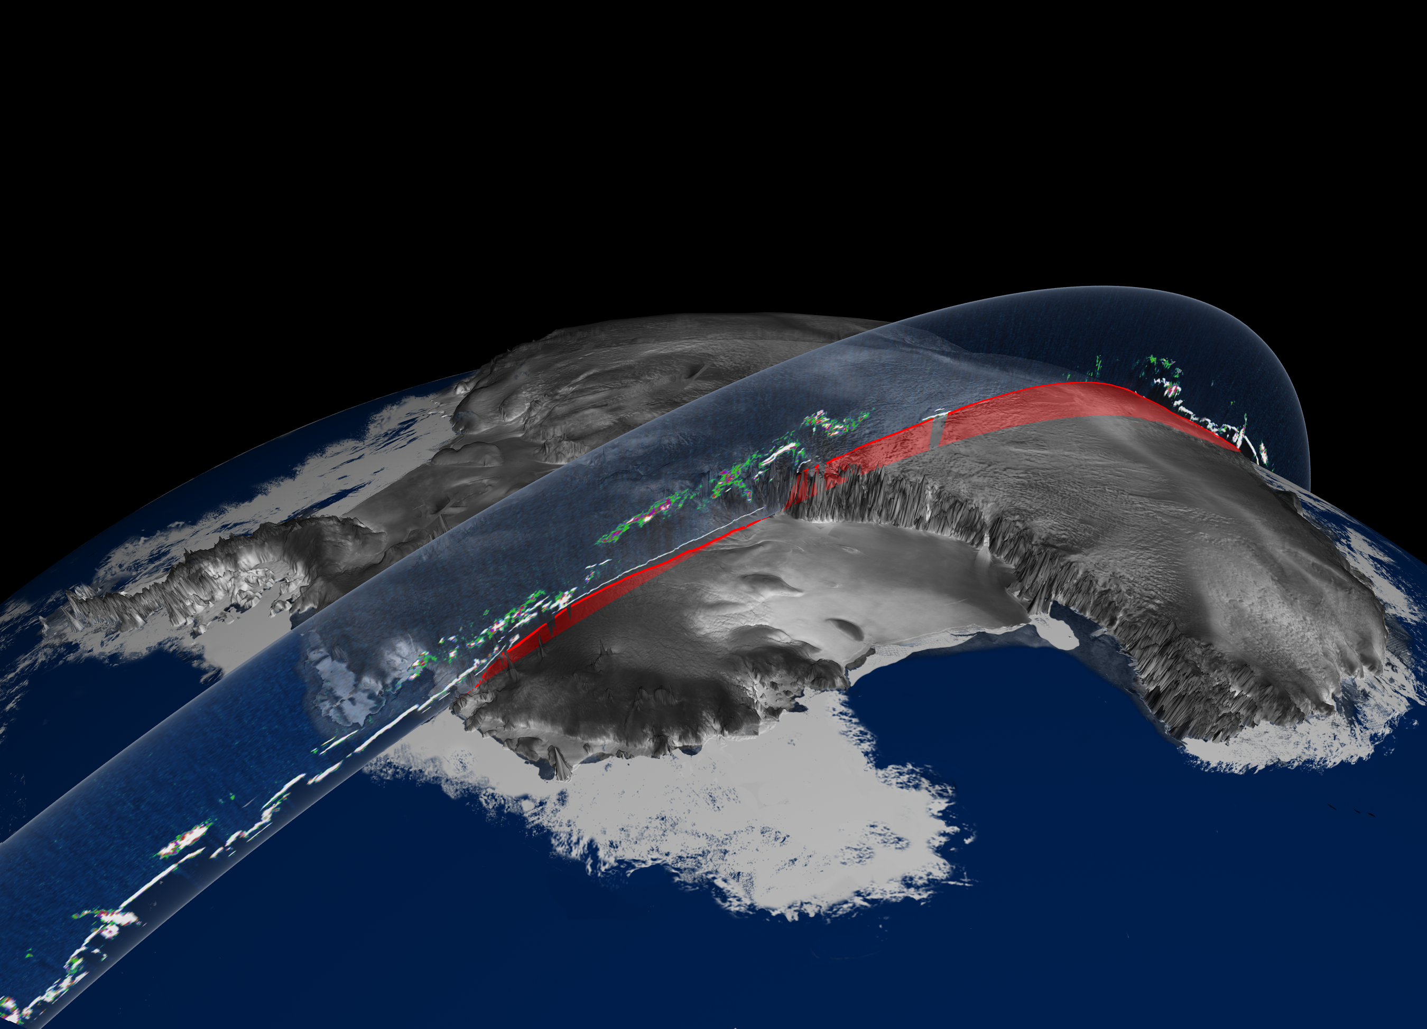
ICESat laser altimetry
A first day track across Antarctica showing ice sheet elevations in red and atmospheric phenomena in varying colors from light blue for thin clouds to white for opaque layers
Vertical exaggeration 50x, 1064 nm data only shown here, RADARSAT mosaic image from CSA
AAASPD, 92nd Annual Meeting @ USD – Fernando Paolo

Slide 13
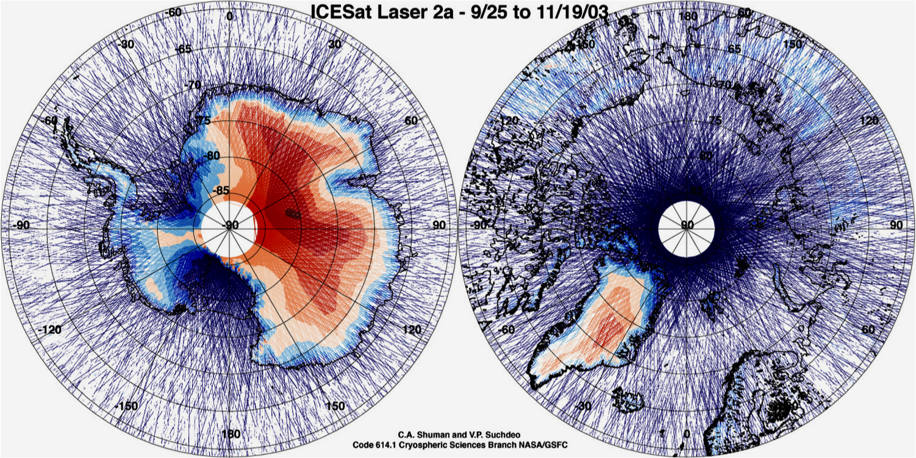
Polar elevation data
AAASPD, 92nd Annual Meeting @ USD – Fernando Paolo

Slide 14
So are the ice shelves changing?

Slide 15
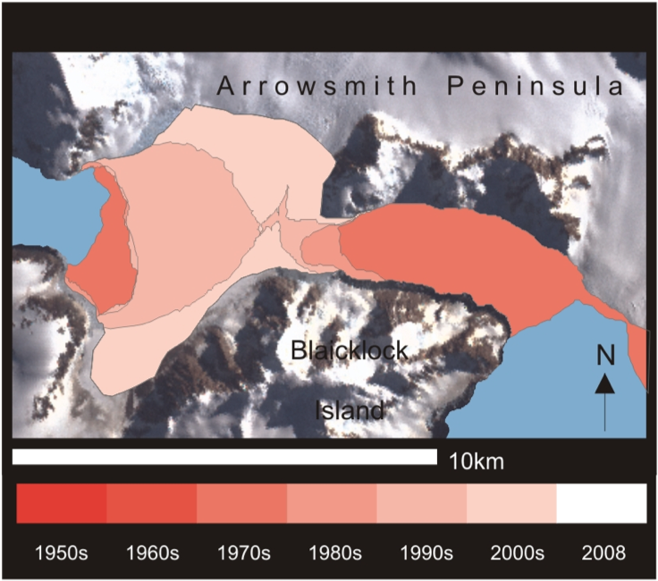
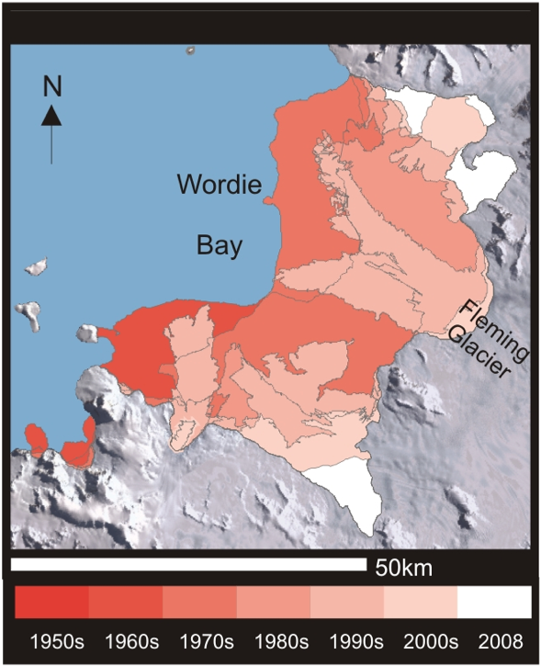
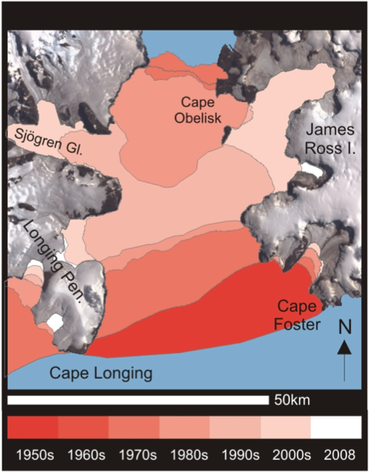
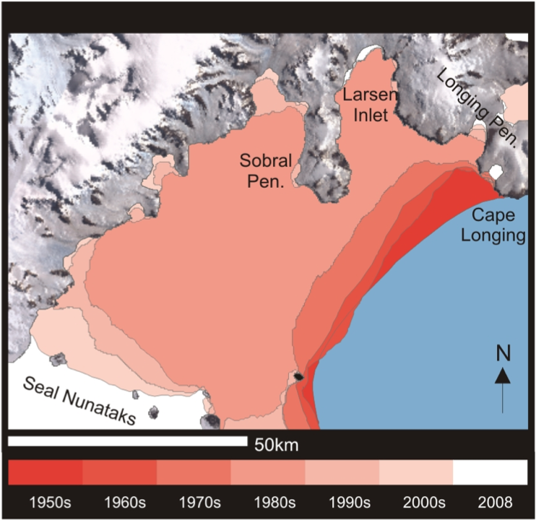
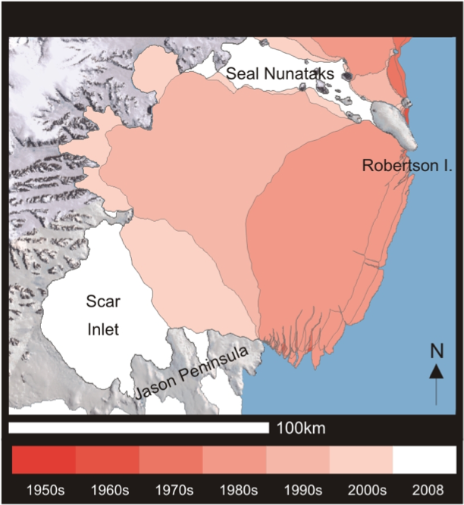
Ice shelf retreat
In 50 years (remaining):
Jones: 0%
Wordie: 10%
P. Gustav: 1%
Larsen A: 10%
Larsen B: 21%
Cook & Vaughan (2010)
Larsen-C
Filchner-Ronne
Ross
Ice velocity metres/year
AAASPD, 92nd Annual Meeting @ USD – Fernando Paolo

Slide 16
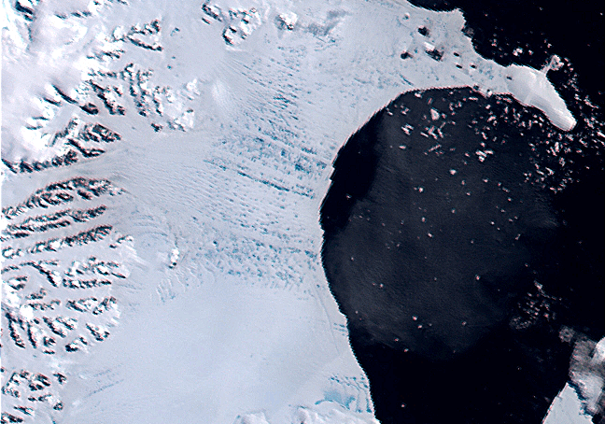
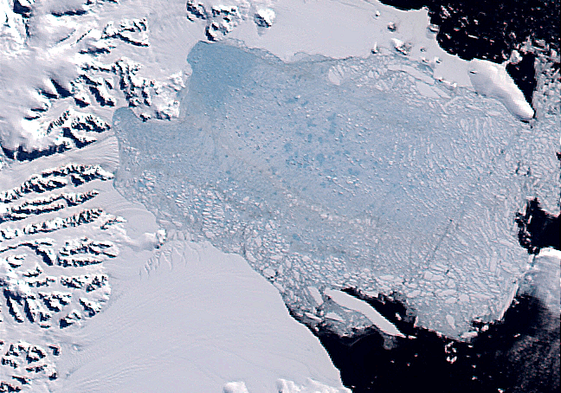
Ice shelf disintegration
January 31 2002
Rapid collapse of Larsen B
Surface melting inducing crack propagation
Terra MODIS images courtesy of Ted Scambos, NSIDC
March 5 2002
Thinning of 1 m/yr (previous)
Precondition vs triggering:
ocean vs atmosphere

Slide 17
Changes in the vertical dimension.

Slide 18
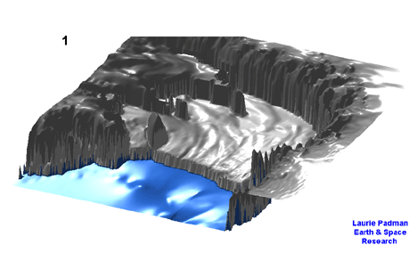
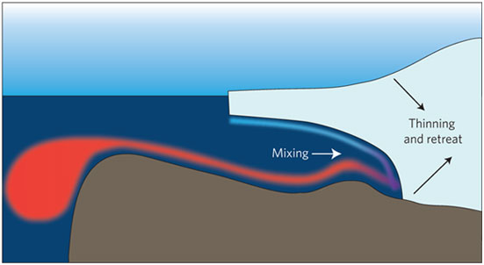
Changes in elevation of an ice shelf
Contributions:
Tides, surface mass balance, basal melt, ice flow divergence, firn compaction, rada penetration…
Tide model of Ross Ice Shelf run over 24 hours
1°C can lead to 10 m/yr melt rate
AAASPD, 92nd Annual Meeting @ USD – Fernando Paolo

Slide 19
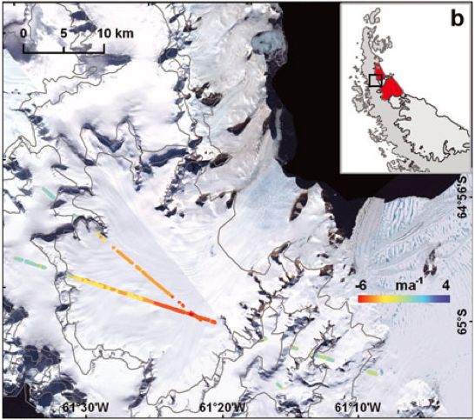
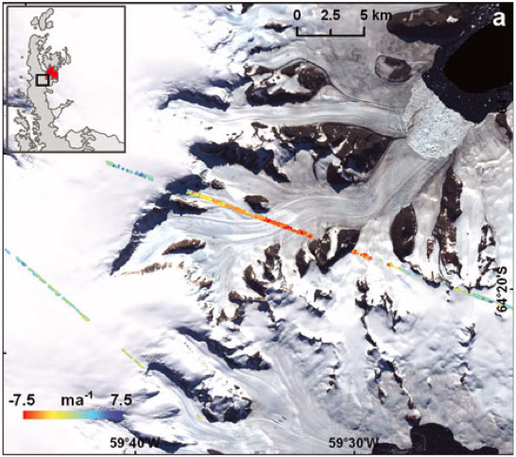
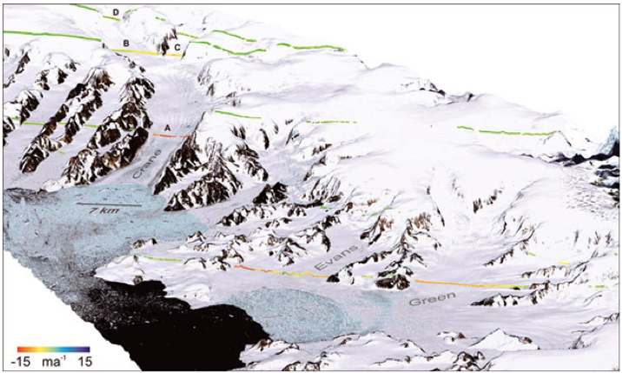
Dynamic thinning after ice shelf removal
Ice shelf collapse prompted rapid dynamic thinning of tributary glaciers
Thinning continued for years to decades after collapse and propagated far inland
Pritchard et al. (2010)
AAASPD, 92nd Annual Meeting @ USD – Fernando Paolo

Slide 20
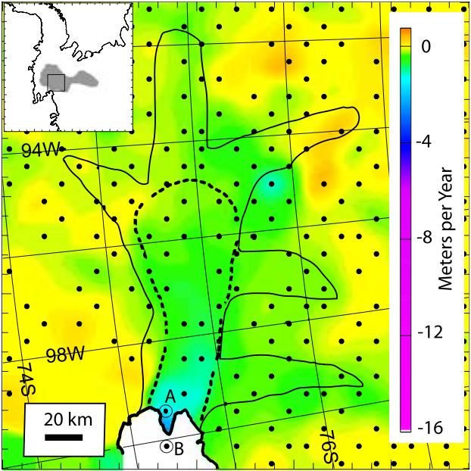
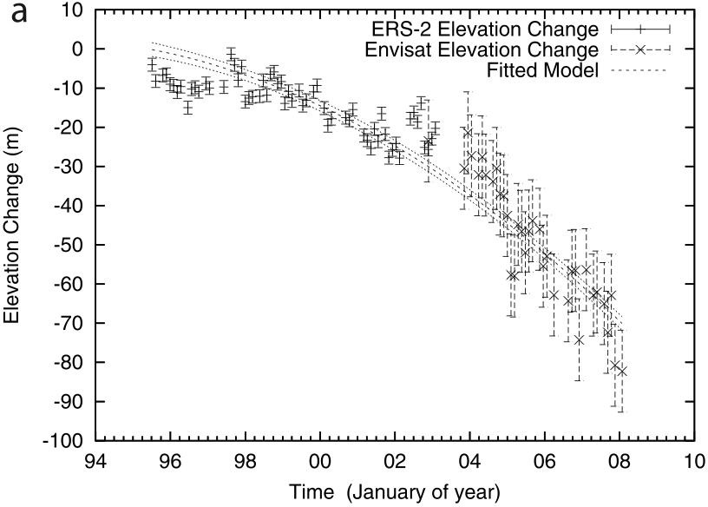
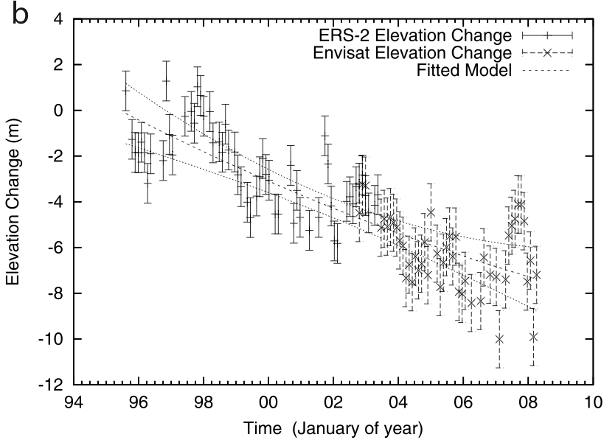
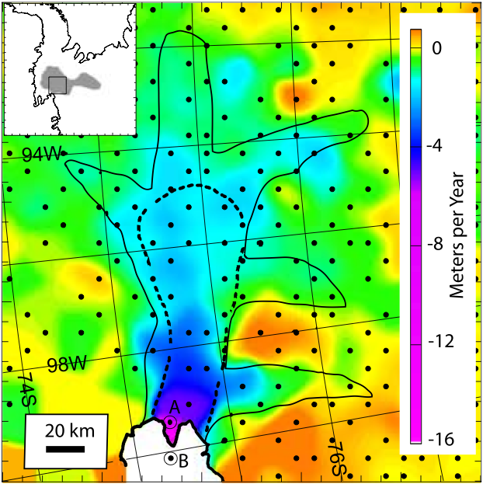
Acceleration in thinning rate
Thinning has accelerated and spread inland to encompass tributaries
At its present rate, the main trunk of PIG will be afloat within some 100 years, six times sooner than anticipated
PIG: 1995 and 2006
Wingham et al. (2009)
AAASPD, 92nd Annual Meeting @ USD – Fernando Paolo

Slide 21
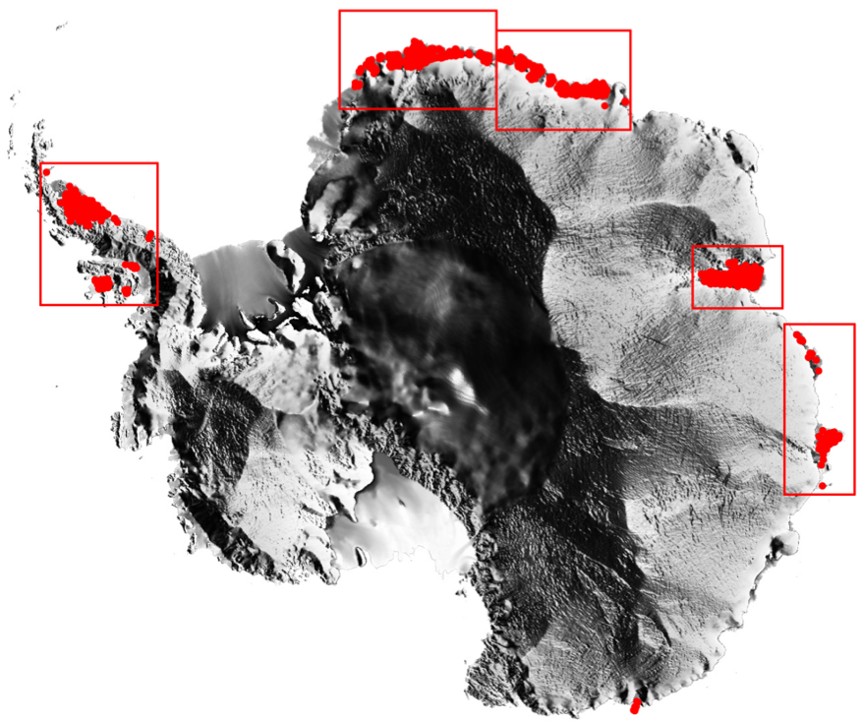
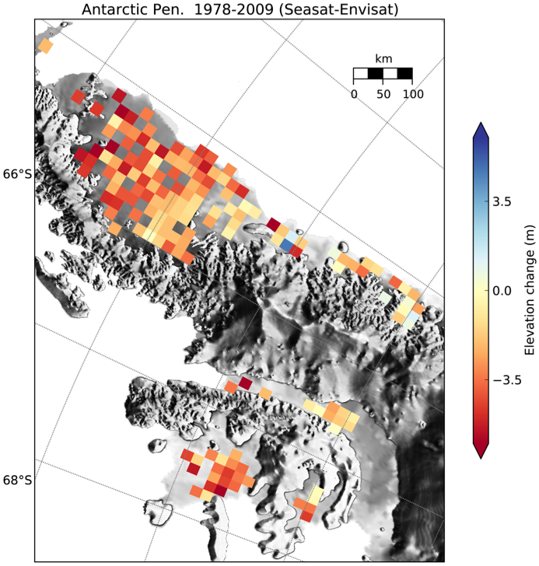
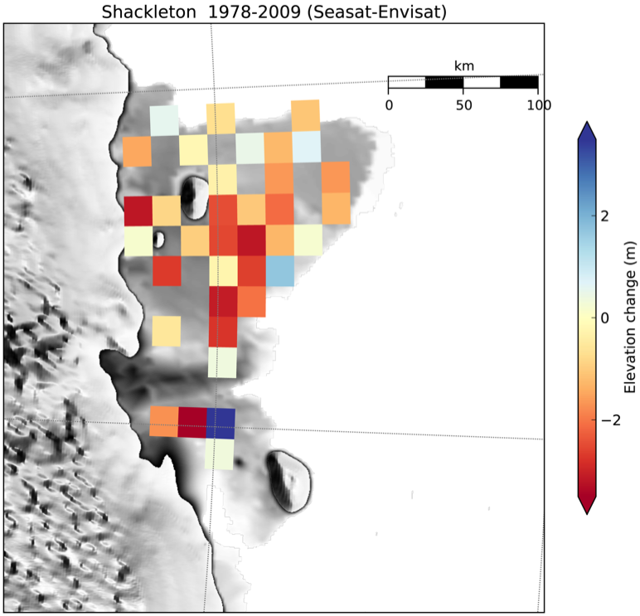
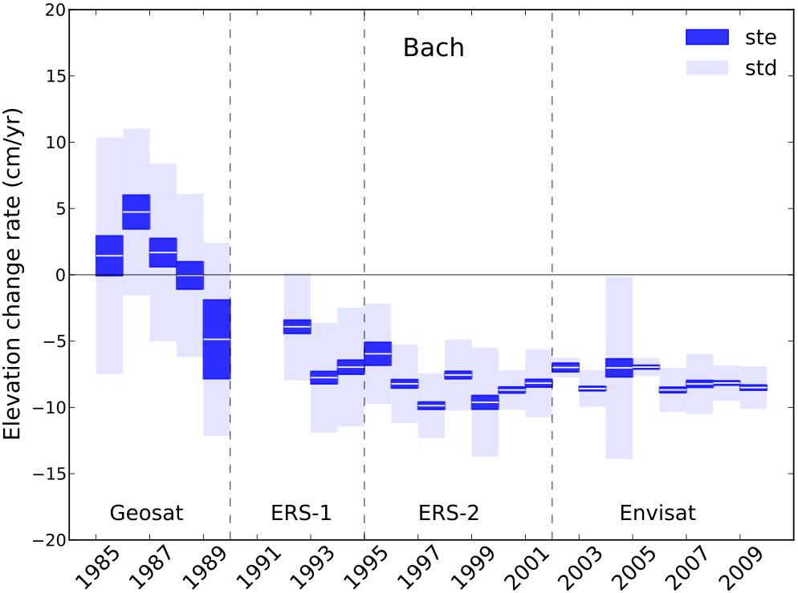
The need for longer time series
Separate long-term trends of climate change from
interannual to decadal natural variability
Spatial variability of surface elevation
Surface lowering started before 1992 (most studies)
AAASPD, 92nd Annual Meeting @ USD – Fernando Paolo

Slide 22
Key questions for the future
The origin of the imbalance lies almost certainly within the surrounding ocean:
long-term warming of the southern oceans or decadal variability in ocean circulation?
While understanding of the physical mechanisms of change continues to improve, the near-future glacial sea-level contribution rely on projections from observations
The question remains as to whether future ice shelf change will be dominated by oceanographic or atmospheric forcing
AAASPD, 92nd Annual Meeting @ USD – Fernando Paolo

Slide 23
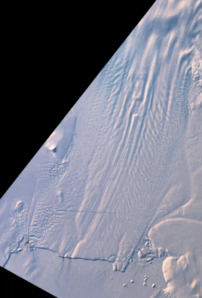
Iceberg calving
Thank you!
NASA/GSFC/LaRC/JPL MISR Team
David Diner (JPL)

